Slide 1
Game Analytics – Unlocking Tennis Data with SportRadar API
Sports/Data Analytics
Roshan A
20/06/2025

Slide 2

Agenda
NOTE:
To change images on this slide, select a picture and delete it. Then click the Insert Picture icon
in the placeholder to insert your own image.
Introduction & Problem Statement
Tools Used
Project Approach
Database Schema & Relationships
Data Analysis - Key Insights & Queries
Streamlit Application –Screenshots
Future Enhancements & Conclusion

Slide 3
Introduction This project aims to develop a comprehensive solution for managing, visualizing, and analyzing sports competition data extracted from the Sportradar API.
Problem Statement
The core challenge is to develop a comprehensive solution for managing, visualizing, and analyzing sports competition data from the Sportradar API.
This involves the need to effectively parse JSON data, store it in a structured relational database, and offer insightful views into tournaments, competition hierarchies, and event details.
Business Use Cases
Event Exploration - Enable users to navigate through competition hierarchies (e.g., ATP Vienna events).
Trend Analysis - Visualize the distribution of events by type, gender, and competition level.
Performance Insights - Analyze player participation across singles and doubles events.
Decision Support - Offer data-driven insights to event organizers or sports bodies for resource allocation

Slide 4
Tools Used
Programming Language : Python
Database: PostgreSQL
API Integration: Sportradar API
Web Application Framework: Streamlit

Slide 5
Project Approach
Data Extraction
Parse and extract data from Sportradar JSON responses using API calls.
Transform nested JSON structures into a flat relational schema for analysis.
API Endpoints collected: Competitions, Complexes, and Doubles Competitor Rankings.
↓
Data Storage
Created a SQL database (PostgreSQL) with a well-designed schema, defining appropriate data types and primary keys.
↓
Data Analysis
Executed various SQL queries to derive insights from the stored data.
Covered competition trends, venue analysis, and competitor performance statistics.
↓
Streamlit Application Development
Connected the Streamlit app with the SQL database for real-time query execution.
Designed interactive dashboards with filters for dynamic data display and analysis.

Slide 6
Database Schema & Relationships
Competition Data from API
Complex Data from API
Double Competitor Rankings Data from API
Categories Table Stores information about categories
Competitions Table Stores information about competitions and links to the Categories table
Complexes Table
Stores information about sports complexes
Venues Table Stores information about venues links to the Complexes table
Competitors Table Stores detailed information about each competitor
Competitor_Rankings Table Stores ranking-related information about competitors, linked to the Competitors table

Slide 7
Data Analysis - Key Insights & Queries
Competition Insights | Venue Insights | Competitor & Ranking Insights
Listing all competitions along with their category names | Listing all venues along with their associated complex name | Getting all competitors with their rank and points
Counting the number of competitions in each category | Counting the number of venues in each complex | Finding competitors ranked in the top 5
Finding all competitions of type 'doubles' | Finding complexes that have more than one venue | Listing competitors with no rank movement (stable rank)
Identifying parent competitions and their sub-competitions |  | Counting the number of competitors per country
Analyzing the distribution of competition types by category |  | Finding competitors with the highest points in the current week

Slide 8
Streamlit Application
Screenshots

Slide 9
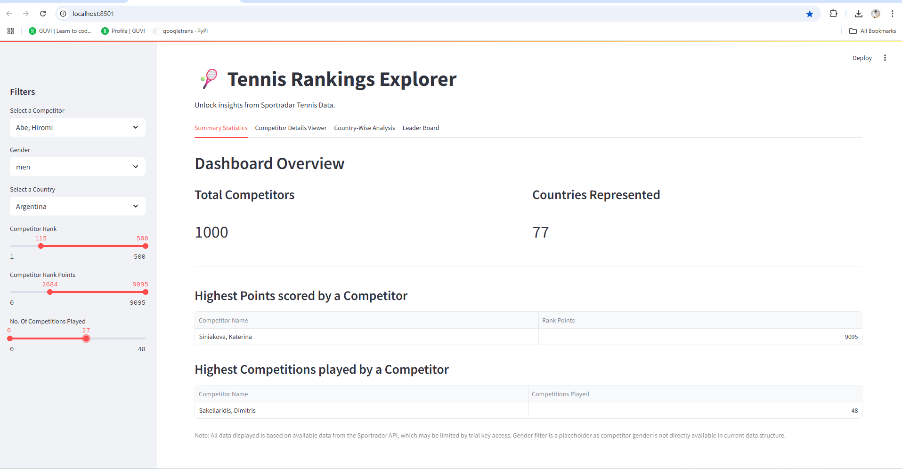
Snip - 1

Slide 10
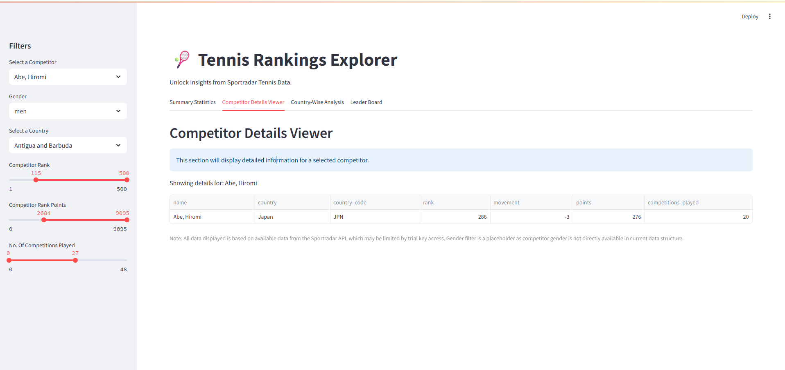
Snip - 2

Slide 11

Snip - 3

Slide 12
Future Enhancements & Conclusion
Future Enhancements
Explore additional Sportradar API endpoints for more granular data (e.g., individual match statistics, historical player performance over time).
Integrate more advanced data visualizations and interactive charts for deeper insights (e.g., competitor performance trends, heatmaps of venue activity).
Implement a robust logging mechanism for tracking API calls, errors, and database operations.
Consider deploying the Streamlit application to a cloud platform for wider accessibility and scalability.
(Optional, if applicable) Incorporate machine learning models for predictive analytics, such as predicting player performance or competition outcomes.
Conclusion
This project successfully delivers a fully functional web application capable of parsing, storing, and visualizing sports event data.
Users can navigate competition hierarchies, filter data, and generate meaningful insights about sports events.
This project significantly enhanced proficiency in working with APIs, databases, and visualization tools

Slide 13
Thank You Roshan A roshana36822@gmail.com

